Slide 1

PV Crystalox Solar plc
2017 Interim Results
24 August 2017

Slide 2
Disclaimer
This presentation has been issued by PV Crystalox Solar plc (the “Company”) and comprises of written materials/slides concerning the Company’s Interim Results for 2017.
The distribution of this document in certain jurisdictions may be restricted by law and persons into whose possession this document comes should inform themselves about, and observe any such restrictions.
No reliance may be placed for any purposes whatsoever on the information contained in this document or on its completeness. No representation or warranty, express or implied, is given by or on behalf of the Company or any of such persons’ directors, officers or employees or any other person as to the accuracy or completeness of the information or opinions contained in this document. In particular, no representation or warranty is given as to the achievement or reasonableness of future projections, estimates, prospects or returns, if any.
Certain statements are included in this presentation, including those regarding customers, costs, potential market share and other statements that express the Company directors’ expectations or estimates of the Company’s future performance, which constitute “forward-looking statements”. Forward-looking statements are necessarily based upon a number of estimates and assumptions that, while considered reasonable by the directors are inherently subject to significant business, economic and competitive uncertainties and contingencies. Such forward-looking statements involve known and unknown risks, uncertainties and other factors that may cause the actual financial results, performance or achievements of the Company to be materially different from its estimated future results, performance or achievements expressed or implied by those forward-looking statements and the Company’s forward-looking statements are not guarantees of future performance. The Company expressly disclaims any intention or obligation to update or revise any forward-looking statements whether as a result of new information, events or otherwise. Investors are cautioned against placing undue reliance on such statements.
The information contained in this presentation is subject to, and must be read in conjunction with, all other publicly available information, including, where relevant any fuller disclosure document published by the Company. Any person at any time acquiring the securities must do so only on the basis of such person’s own judgement as to the merits of the suitability of the securities for its purposes and only on such information as is contained in public information having taken all such professional or other advice as it considers necessary or appropriate in the circumstances and not in reliance on the information contained herein. The information is not tailored for any particular investor and does not constitute individual investment advice. Any information in this presentation relating to the price at which investments have been bought or sold in the past or the yield on investments cannot be relied upon as a guide to future performance.

Slide 3
Market Overview
Price erosion continues across the value chain
  Prices remain decoupled from production costs
  High efficiency monocrystalline silicon products increasing market share
China increasing its dominant position in PV manufacturing
  Cell production in China increased to 32GW in H1 2017 -up 28% on H1 2016.
  PV module production reached 34GW -up 26% on H1 2016.
China is largest PV end market- 24GW installations added in H1 2017
  Further 10.5GW added in July
  Cumulative installations now exceed the 105GW target set for 2020
USA has launched new enquiry into imports of PV cells and modules
  Complaint filed in April under Section 201 of the Trade Act of 1974 by PV company Suniva
  Imports alleged to be “substantial cause of serious injury” to US manufacturing
  US International Trade Commission will decide by 22 September

Slide 4
H1 Overview
Wafer shipment volumes 69MW (H1 2016: 59MW)
  Shipment volumes broadly in line with production output
  Focus on low carbon footprint wafers supplied to customer targeting French PV market
Ingot/block production to be shutdown in UK
  Operations to cease at end August
Wafering operations to continue at Group’s facility in Germany
  Blocks to be purchased from third party suppliers
  French PV market carbon footprint incentives favourable for wafering in Germany.
    Polysilicon trading significantly reduced as inventory level much lower
  No purchase obligations under long term polysilicon contracts
  Trading of polysilicon continues albeit at lower level than 2016
No resolution of dispute with LT wafer contract customer
  Request for ICC arbitration filed in March 2015
  Evidentiary hearing held in March 2017
  Judgement expected by end-September 2017

Slide 5
H1 Overview
Multicrystalline wafer prices >20% lower than in H1 2016
Supply tightening and prices sharply increasing during recent weeks
  Short term effect driven by strong demand from China/USA end-markets
  Polysilicon production shortfall in China during Q3
Notes:
4

Slide 6
Financials

Slide 7
Financial Overview
Revenues €12.6m (H1 2016: €34.7m)
Loss before taxes €(5.4)m (H1 2016: Profit of €4.7m)
Net cash of €27.9m at 30 June 2017 (31 Dec 2016: €28.8m)
Inventories of €7.4m at 30 June 2017 (31 Dec 2016: €11.2m)

Slide 8
Summary consolidated income statement
(€'000) |  | 30-Jun-17 | 30-Jun-16 | 31-Dec-16
Revenues Cost of materials and services Overheads Other income |  | 12,587 (12,845) (6,396) 1,161 | 34,705 (28,537) (5,804) 1,792 | 56,732 (48,622) (15,707) 5,376
Currency gains/(loss) |  | 106 | 2,578 | 3,860
(Loss) / Profit before interest and taxes (EBIT) Net finance income/(cost) (Loss) / Profit/before taxes (EBT) Income taxes (Loss) / Earnings Earnings per share (€ cents) |  | (5,387) 20 (5,367) - (5,367) (3.4) | 4,734 5 4,739 - 4,739 3.0 | 1,639 61 1,700 44 1,744 1.1

Slide 9
Summary consolidated balance sheet
(€m) | 30-Jun-17 | 30-Jun-16 | 31-Dec-16
Current Assets | 37.6 | 43.8 | 43.8
Non-current Assets | 1.2 | 7.6 | 1.8
Total Assets | 38.8 | 51.4 | 45.6
Current Liabilities | 2.9 | 5.5 | 3.5
Non-current Liabilities | 0.1 | 0.3 | 0.3
Share Cap & Reserves | 35.8 | 45.6 | 41.8
Total Liabilities and Shareholder Equity | 38.8 | 51.4 | 45.6
Notes:
8

Slide 10
Summary consolidated cash flow
Summary cash flow analysis (€m) | 30-Jun-17 | 30-Jun-16 | 31-Dec-16
Operating cash pre-working capital after taxes | (3.3) | 5.2 | 2.7
Changes in working capital Exchange difference Net cash flows in investing activities | 3.1 (0.7) - | 8.2 (1.2) (0.1) | 15.2 (1.7) (0.1)
Net change in cash in period | (0.9) | 12.1 | 16.1
Cash and equivalents, start of year | 28.8 | 12.7 | 12.7
Cash and equivalents, end of period | 27.9 | 24.8 | 28.8

Slide 11
Global PV Market

Slide 12
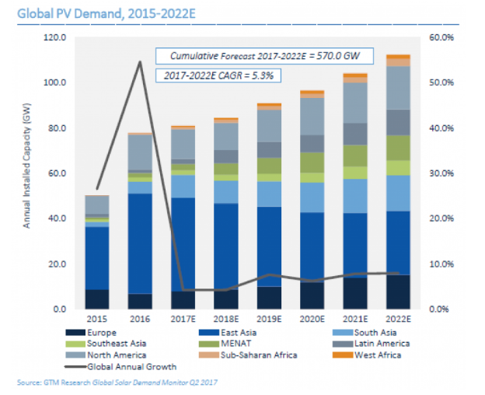
Global PV Demand Forecast (GW)
Modest growth expected for 2017 global PV installations
  85GW forecast for 2017-up 4% on 2016
  China is key driver of demand and remains largest market for fifth successive year

Slide 13
Outlook

Slide 14
Outlook
85GW forecast for global PV installations in 2017
  Only modest 4% growth compared to double digit growth seen in previous years
  China remains the major global market and will account for > 40% of demand
Pricing pressure expected to increase in Q4
  Slowdown of PV installations in China
  Supply of wafers for French PV market may offer some modest relief on pricing
Arbitration judgement expected by end September 2017
  Outcome is uncertain but as stated in March 2016 the value of any award if our claim is upheld could be a multiple of the Group’s market capitalisation
  Completion of strategic review awaits decision on arbitration claim

Slide 15
Q&A

